Slide 3
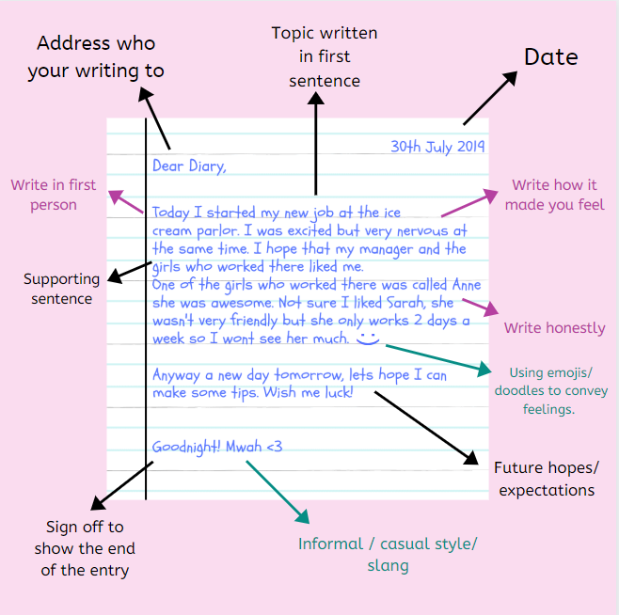

Slide 4
Date, Day
What you saw/experienced
Your reaction to what you saw/experienced
Style
A diary entry is personalized so write in first person.
At times you may leave out the pronoun ‘I’. For example, “am really excited …’’/“Went to the beach today …”
Refer to personal memories and give details.
Use conversational and friendly language.
Refer to parents, friends, etc. as how you would address them in person. For example, “Mom said …’’/“Rohit came along …’’/“Shweta just wouldn’t listen ….”
Stress on feelings, emotions, reactions rather than on the event itself. You may mention the time of the entry as well.

Slide 5
Format:
Top left – Date, day and time.
Tense most frequently used – Simple past, Present perfect and future.
Written in the first person.
Steps:
Begin the entry with a general sentence describing the day or your feelings.
In the body, you may discuss an event, your feelings towards it. How it is likely to affect your future plans.
Conclude with a final remark and future course of action.

Slide 6
Write a diary entry describing the favourite time of your day. Answer:
06-01 2016 Monday,
2:30 p.m.
Dear Diary My favourite time of the day is between 5 p.m. to 7 p.m. This is the time when the sun is set and the air starts cooling down. At this time I either go for a stroll, play some games or sit quietly watching the activities around me. Sitting quietly doing nothing, in particular, is what I like the most.
The compound surrounding my house is a fairly large one. So my father has planted many trees in it. Birds of all sorts come to the trees in the evening and sing their sweet songs. I just sit under my favourite rambutan tree and listen to those lovely birds. However, I cannot just sit quietly all the time. My parents sometimes ask me to mow the lawn or help them in some gardening tasks.
These I do gladly for the air is nice and cool. Working under a hot sun is one thing I do not like. In the evening the sun is soft and gentle. It is pleasant to work in the garden then. Other times I might go out for a stroll or play games with my friends. In fact, many people come out of their houses to breathe in the cool evening air and to relax a bit, unless it is raining. This is the time of the day when the playing fields, parks and other recreational areas are filled with people. I guess I am not the only one who enjoys a nice outing in the evening.
Your Name

Slide 7
Recently you visited the old age home in Delhi. You met old people who were lonely and sick. Their children had left them to fend for themselves. When you talked to them, you felt bad about the fact that they were not living with their children. Write about your experiences in your diary. Answer:
Friday, 30th November, 20XX 7:30 pm
Dear diary, Today, I visited an old age home. I was surprised to see the condition of the old people there. Even though the medical facilities and food were good, it was disheartening to see that most of them were under depression. Their children had abandoned them. Some had forcefully kicked them out of the house. So now, they have nowhere to go. When I talked to them, my heart was filled with sympathy for them. What could I do to make them happy? I told them some jokes and riddles, but they seemed to be unmoved by the humour. I spent some time with them and promised myself one thing. I will look after my parents when I grow up. I will never leave them like this. I wondered why people misbehave with their parents like this. Parents should be respected and loved because parents are the best people in this world.
Your Name

Slide 8
CONTENT SLIDE

Slide 9
QUESTIONS RELATED TO ABOVE SLIDES

Slide 10
REFERENCES & THANKING SLIDE

